Slide 1


Conversational AI Chatbot for Tele-communication.
Jaspreet Bhatia.

Slide 2


AGENDA
Business Case.
Proposed Architecture.
Screenshots
Advantages/Limitations.

Slide 3
Business Case
Current scenario:
Huge amount of data flowing in daily.
Storing the voice/text transcripts.
Analysis of the conversations spoken in different languages (English , French etc.) for business cases (Internet, billing etc.)
Context-based Topic modeling for identifying the major issues in the conversations.
Storing the results of the topic model.

Slide 4
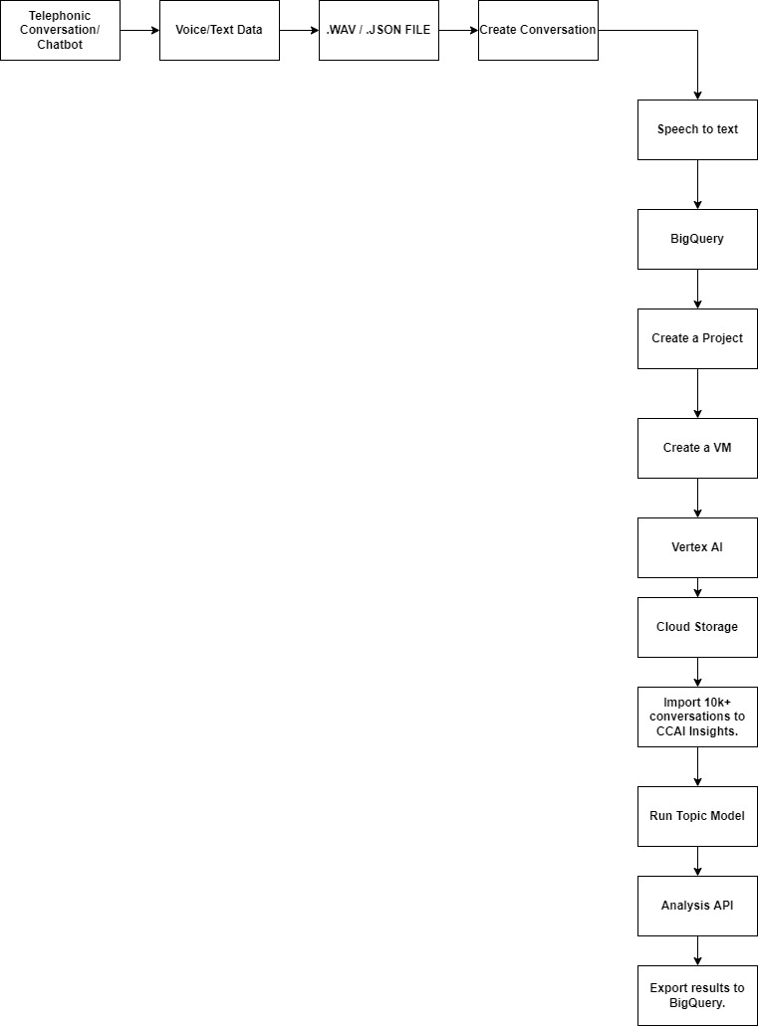
Proposed Architecture

Slide 5

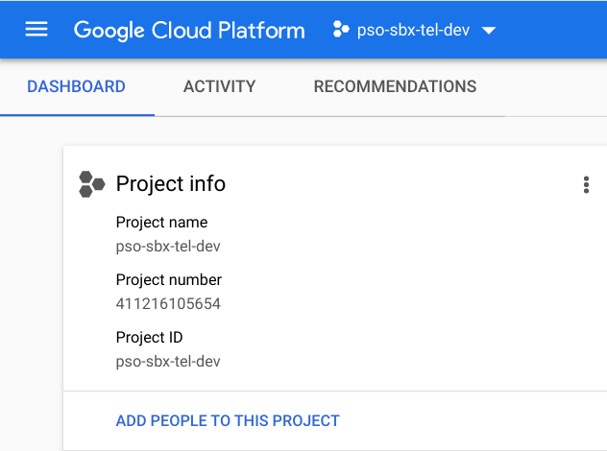
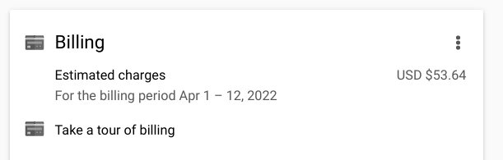
PROJECT

Slide 6
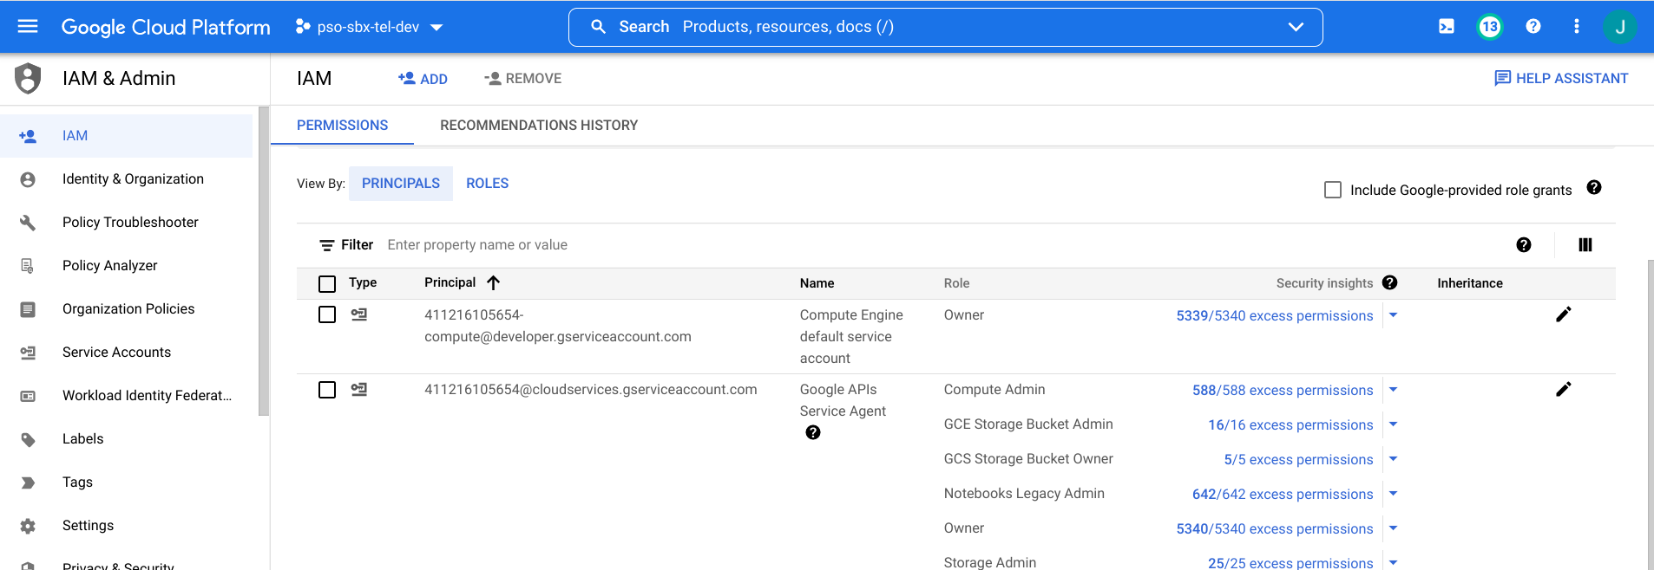
Project I AM Roles

Slide 7
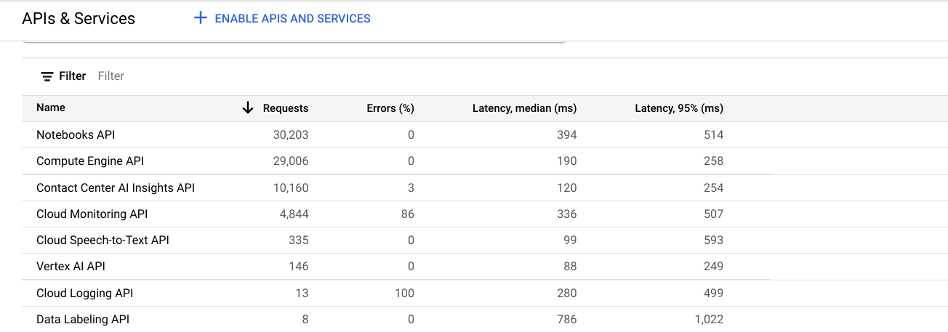
API

Slide 8
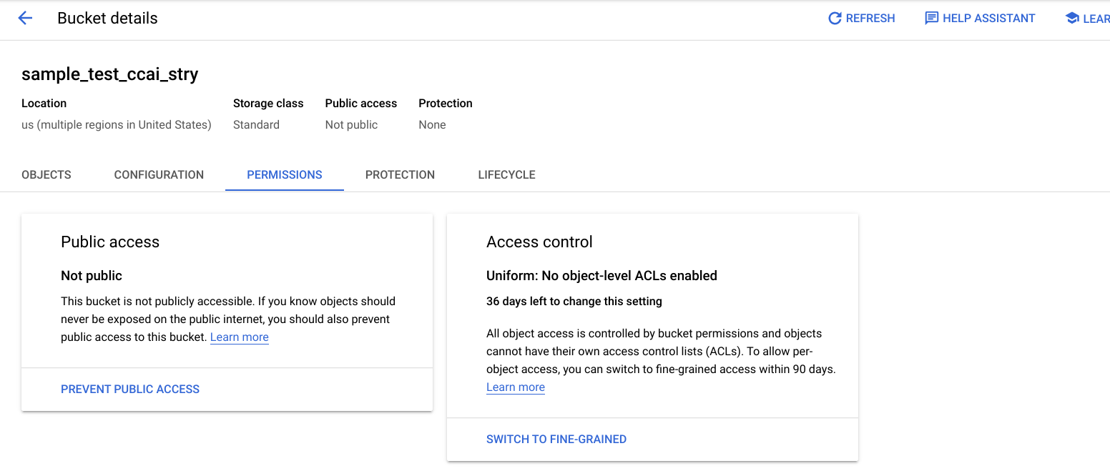
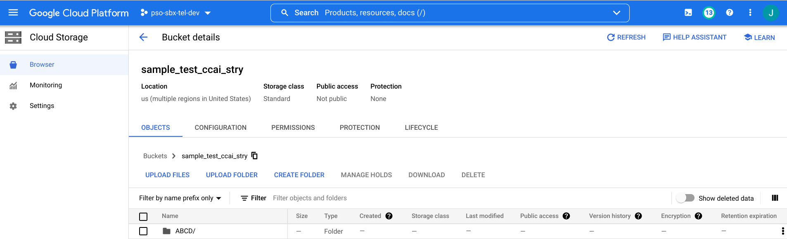
CLOUD STORAGE

Slide 9
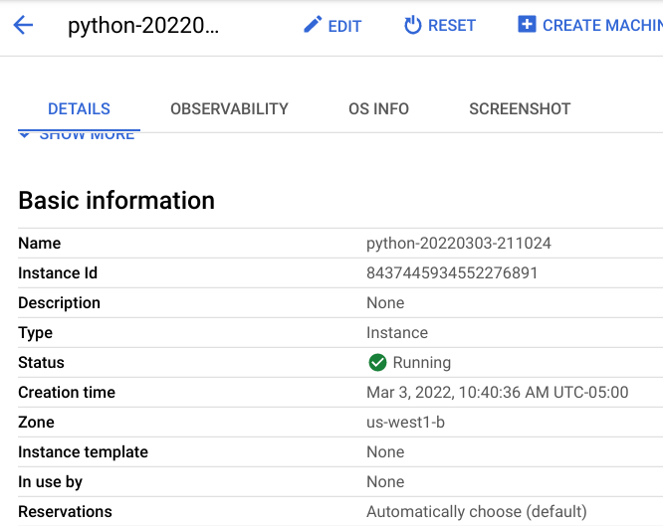
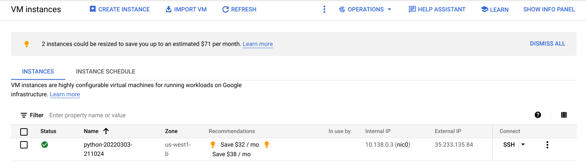
VM INSTANCE

Slide 10
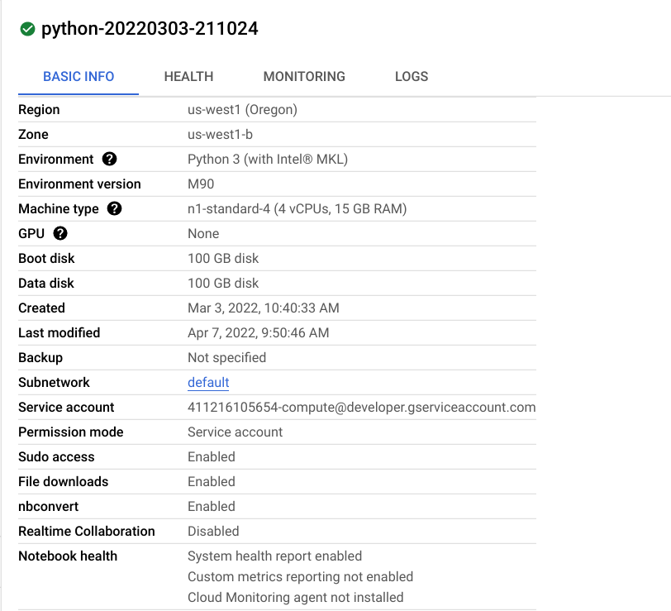
VERTEX AI WORKBENCH

Slide 11
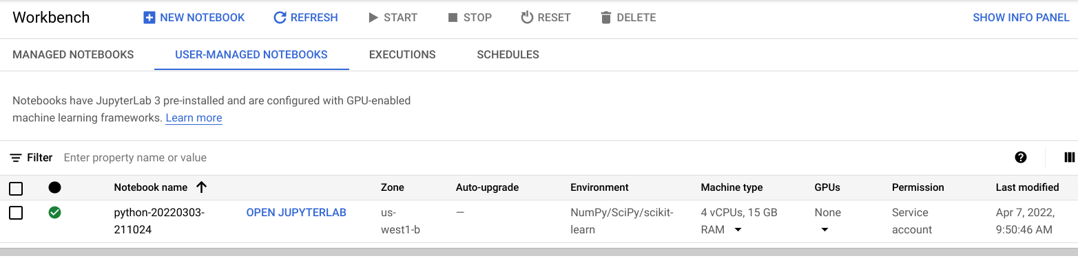
NOTEBOOK DETAILS

Slide 12
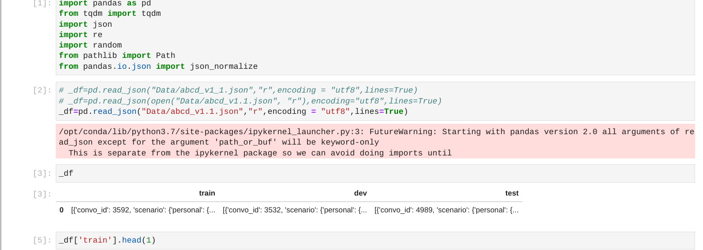
NOTEBOOK

Slide 13
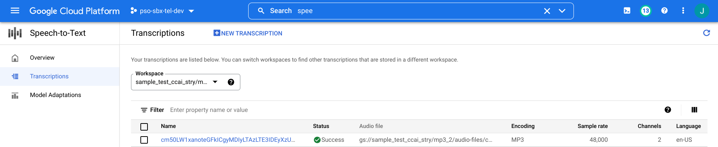
SPEECH-TO-TEXT

Slide 14
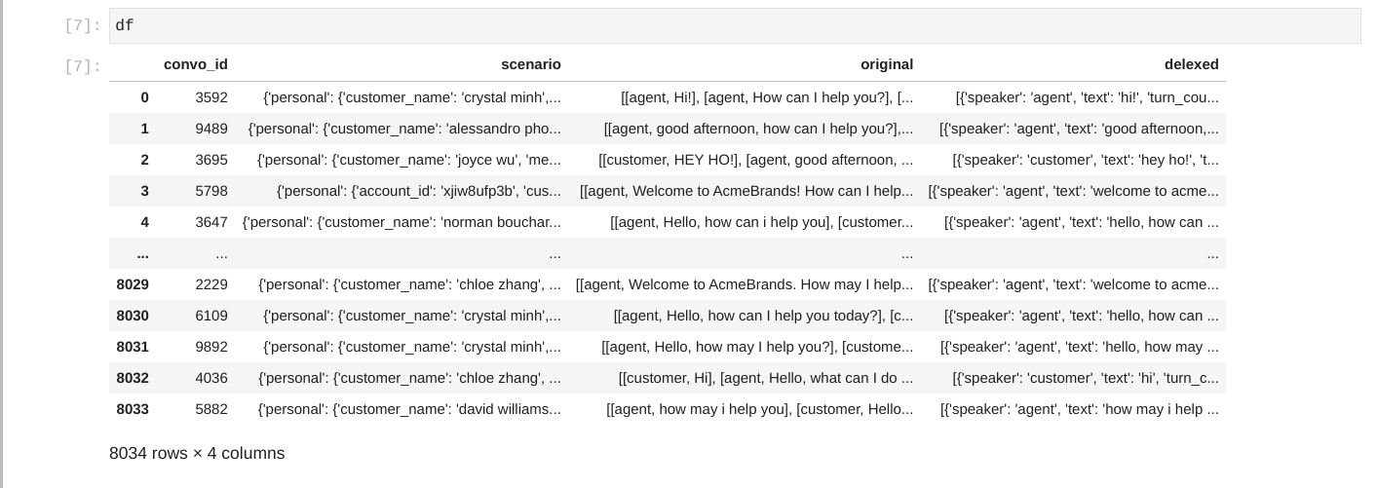
Action Based Conversation Dialogue (ABCD) Dataset.

Slide 15
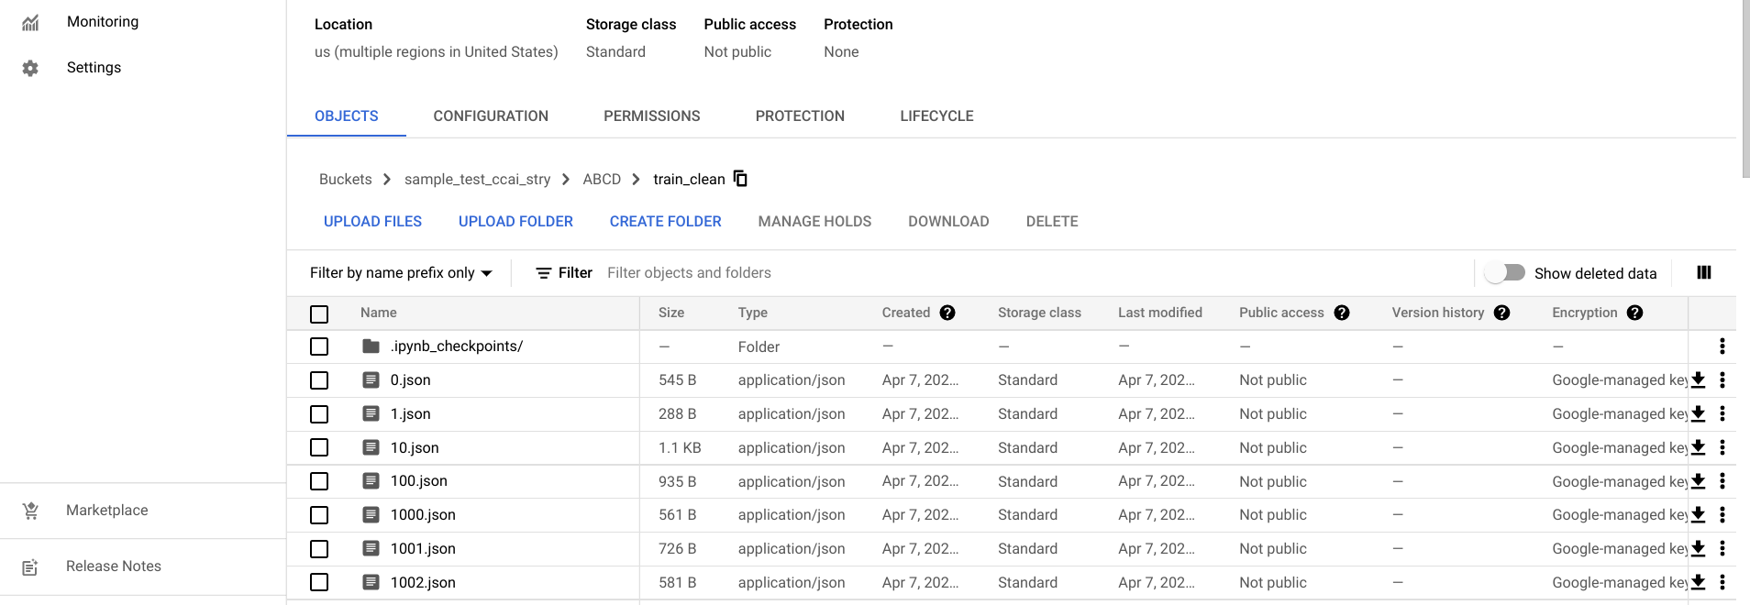
DATA CLEAN-UP

Slide 16
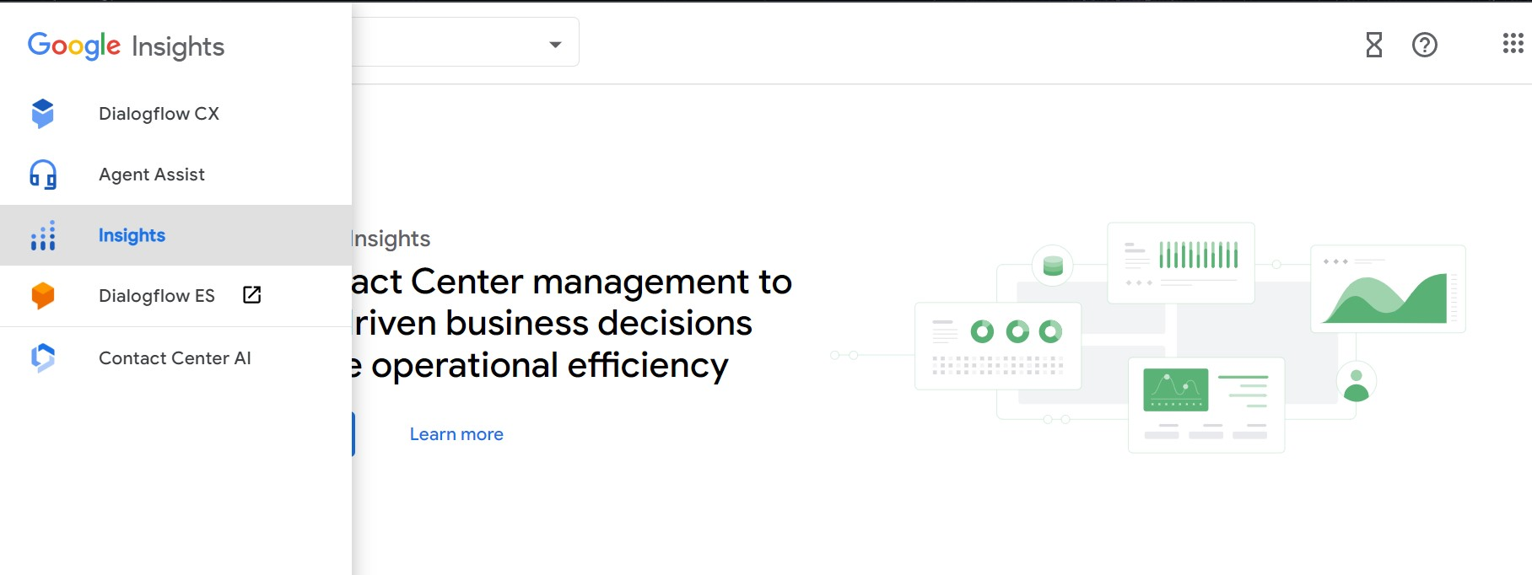
GOOGLE CCAI INSIGHTS

Slide 17
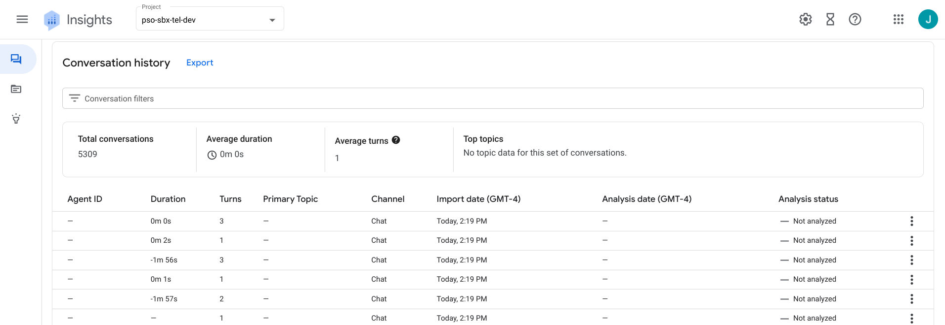
CONVERSATION HUB

Slide 18
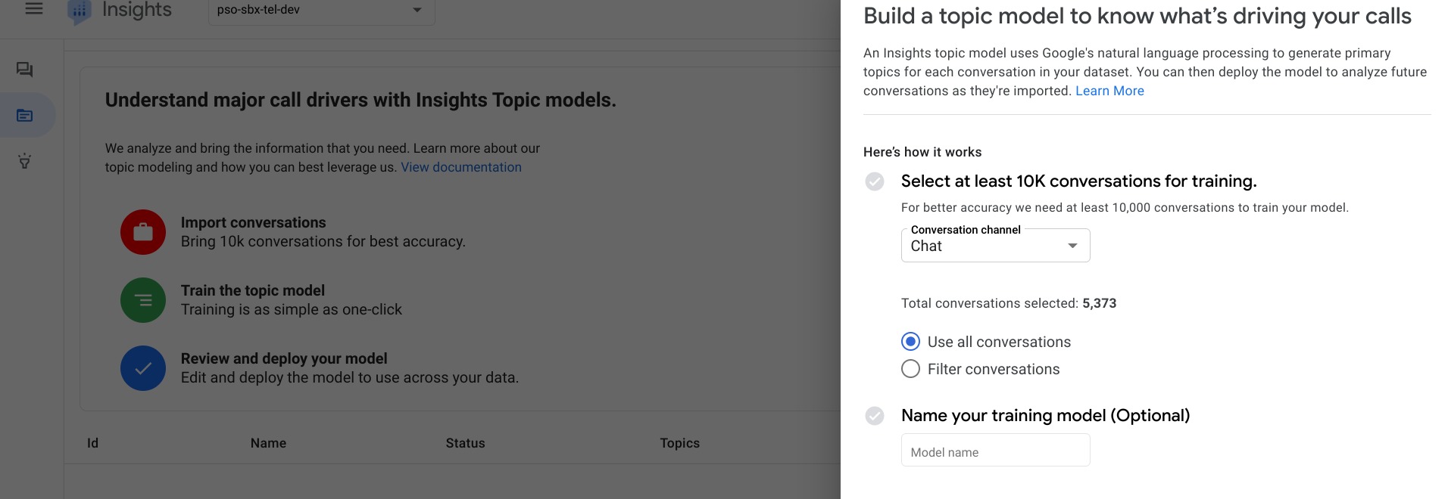
TOPIC MODEL

Slide 19
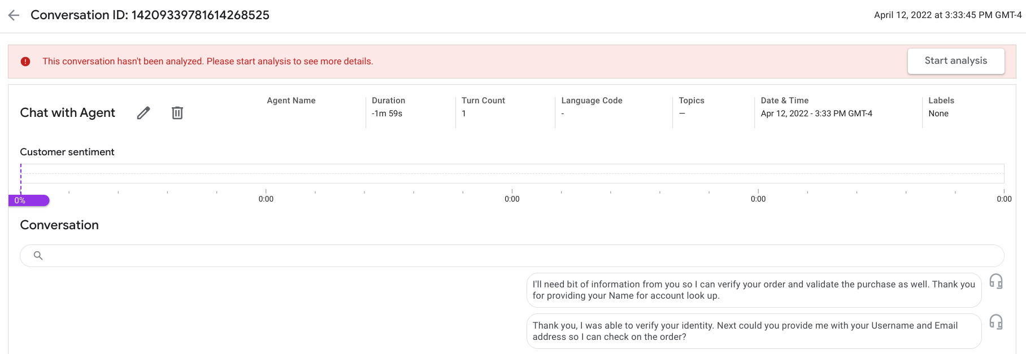
ANALYSIS API

Slide 20
LIMITATIONS
Conversations may contain personal details like Credit card, Pin number etc.
Speech to text should correctly highlight more important phrases after conversion.
Data Privacy to be maintained.
Huge data storage, storage time, data analysis required.
Updating the input data as more data flows in from different business use-cases.
Topic Model to be updated over time.

Slide 21
REFERENCES
UofT class lectures/notes/assignments.
Google Cloud Documentation.
Google CCAI documentation.
NLP textbooks.
ABCD open-source dataset.

Slide 22

Thank You

